Slide 1

Sample PowerPoint Tips
~Byron K Patrick, CPA.CITP | CGMA

Slide 2
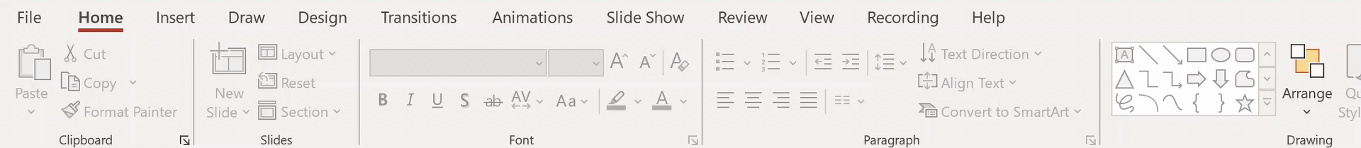

The Slide Master

Slide 3
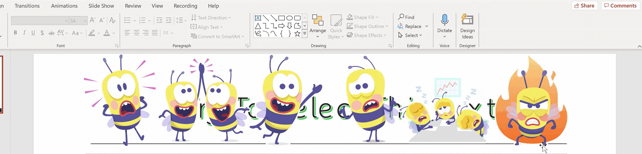






The Selection Pane
Try To Select This Text

Slide 4
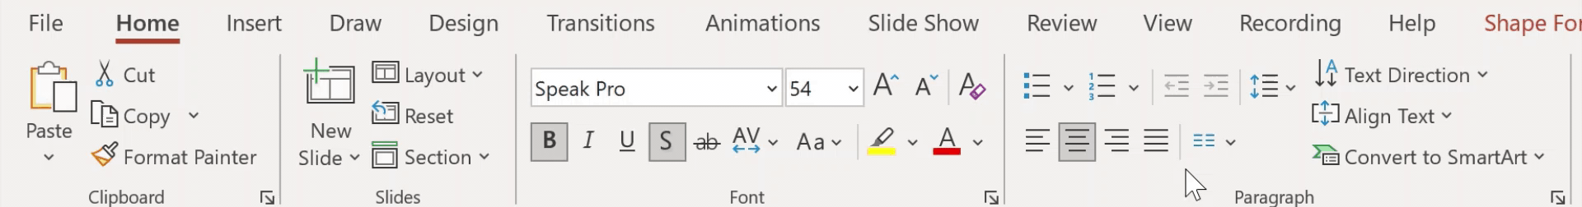
Morph Transition
Notes:
Put the deck in presentation mode to experience the Morph

Slide 5
Morph Transition

Slide 6
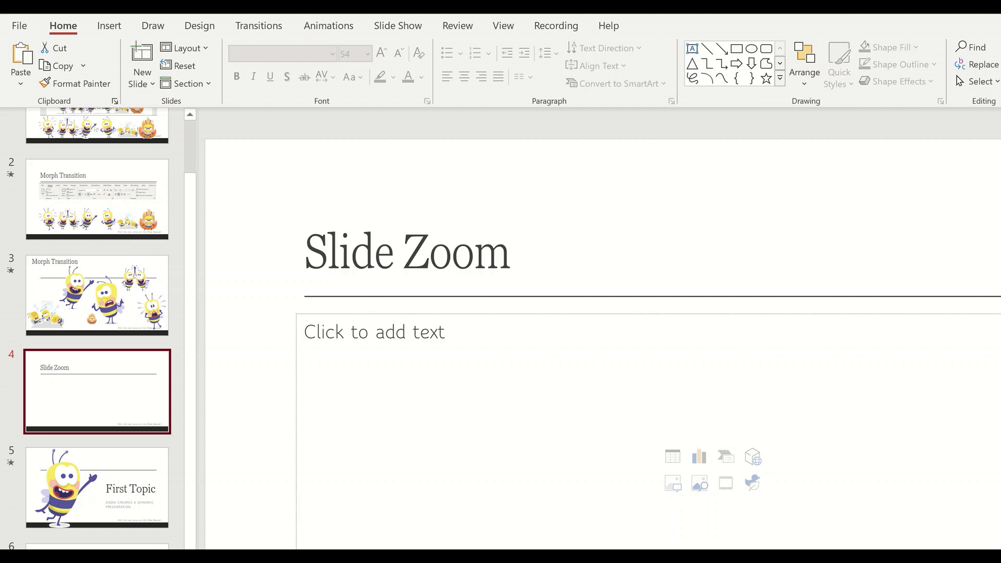



Slide Zoom
Notes:
Put the deck in presentation mode to experience the Zoom

Slide 7
First Topic
Zoom creates a dynamic presentation

Slide 8
Second Topic
You can use “Slide Zoom” to create a choose your own adventure

Slide 9
Third Topic
Up you slide zoom game using “Sections”

Slide 10

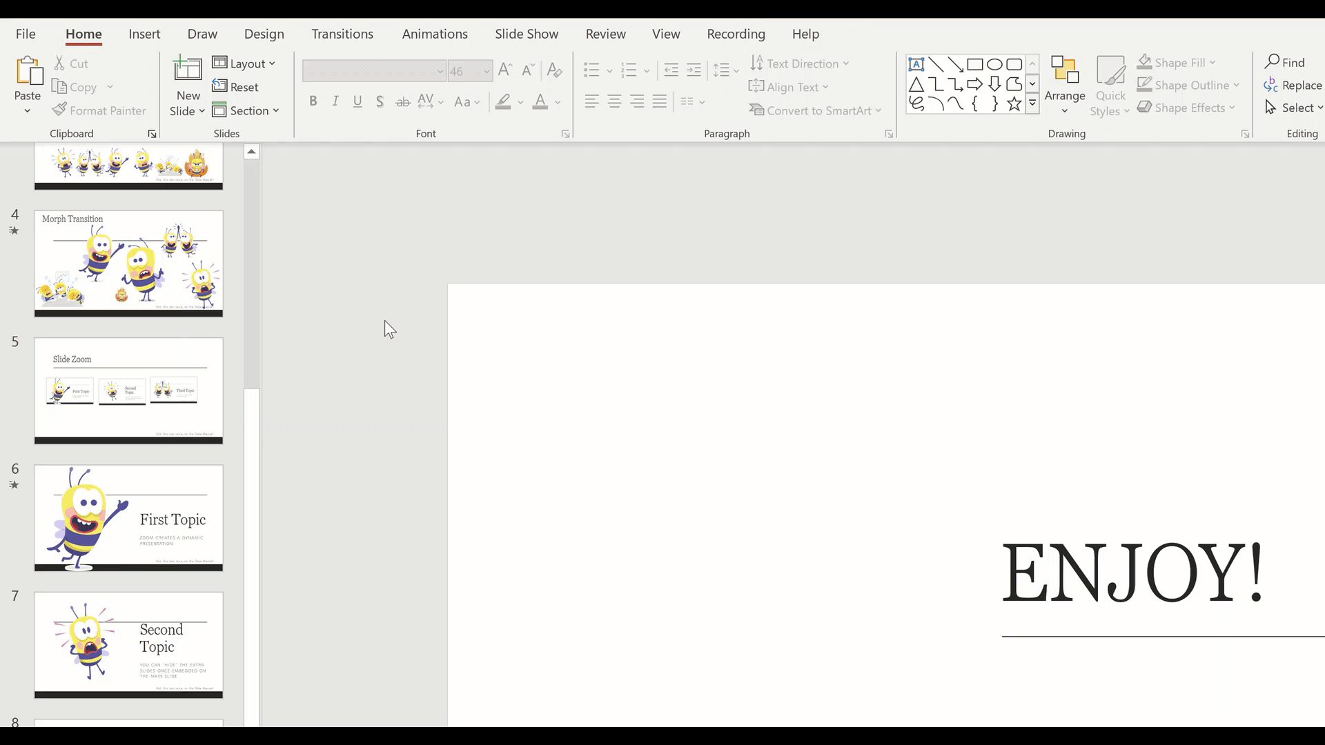
ENJOY!
Wondering where I got those cute bumble bees from?

